Slide 1


OCES Course Enrollment System
Final Project Presentation
Phillip Achemire
University of Arizona Global Campus
Capstone for Computer Software Technology (CST499)
Charmelia Butler
12/8/2025

Slide 2

Project Overview
Purpose: Web app for student registration and course enrollment
Goals:
Secure login and profile management
Reliable enrollment with waitlist support
Comprehensive audit logging
Technology Stack:
Backend: PHP
Database: MySQL
Frontend: JavaScript for profile and enrollment UI
Sources:
(Bharamagoudar et al., 2013)
(Walia & Gill, 2014)

Slide 3

Software Requirements Specification Highlights
Functional Requirements:
Register
Login
View profile/catalog
Enroll
Cancel
Waitlist promotion
Nonfunctional Requirements:
Security
Data integrity
Logging
Performance targets
Acceptance Criteria:
Endpoints return JSON
Tests pass
Enrollment and waitlist operations are atomic
Sources:
(Bharamagoudar et al., 2013)
(Kaluarachchi, 2025)

Slide 4
Error Handling and Logging
Centralized error_handler.php for uniform JSON error responses
logging_handler.php writes structured JSON logs to backend/logs/app.log
HTTP Code Mapping:
400: Validation
401: Authentication
403: Authorization
500: Internal error
Sources: (Walia & Gill, 2014; Eludire & Arakeji, 2011)

Slide 5

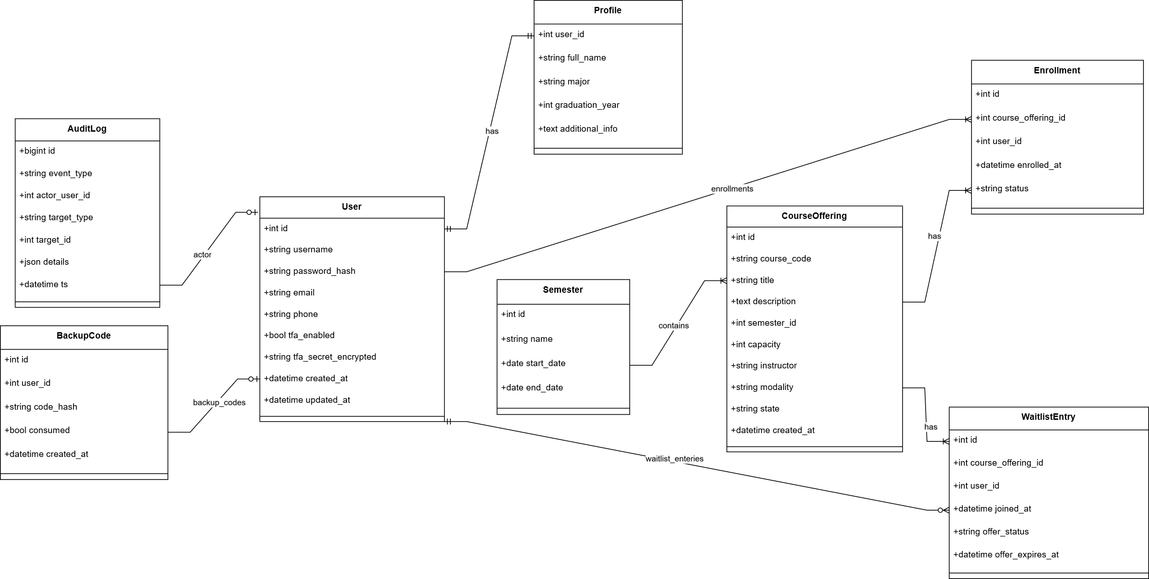
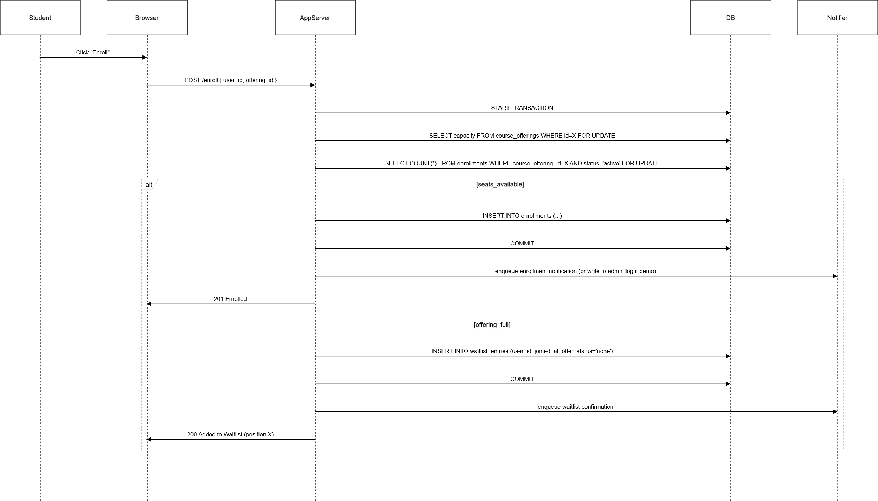
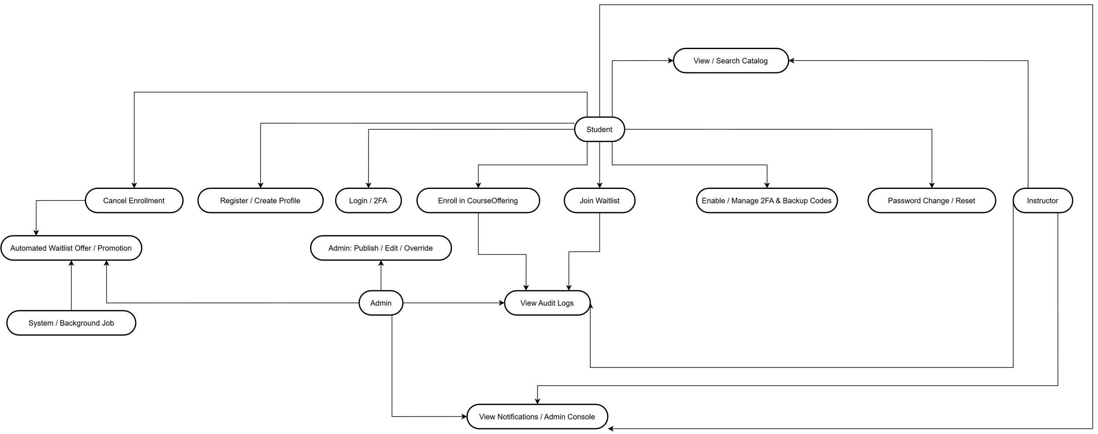
Sequence Enrollment
Class Diagram
Use Case
UML and Architecture

Slide 6
Database and Schema
Key tables: tblStudents, tblCourses, tblEnrollments, tblWaitlist
PII stored encrypted: *_enc columns for sensitive fields
Indexes and unique constraints for performance and integrity
Schema and seed files: backend/sql/schema.sql, backend/sql/course_inserts.sql
Sources: (Eludire & Arakeji, 2011; Walia & Gill, 2014)

Slide 7
Landing, Login and Profile UI
Landing page:
links and session-aware navigation
Login:
POST to backend/api/login.php with CSRF token from csrf.php
Profile:
frontend/site/profile.html + frontend/site/js/profile.js
Fetches profile_get.php and courses.php for rendering

Slide 8
Enrollment and Waitlist Logic
Enroll Flow:
Check capacity
Start transaction
SELECT FOR UPDATE, insert into tblEnrollments or tblWaitlist, commit
Cancel Flow:
Delete enrollment
Promote earliest waitlist entry in same transaction
Concurrency control:
Transactions and row locking
Source:
(Bharamagoudar et al., 2013)

Slide 9

Code Highlights and Tests
Profile fix: decrypt *_enc columns before returning JSON
Enrollment: atomic transaction in enroll.php with promotion on cancel
Tests: PHPUnit unit and integration tests in tests/ and tests/integration/
Dev tools: tools/create_default_students.php, tools/fill_courses.php

Slide 10

Testing, Validation and Exit Criteria
Unit tests:
Input validation,
Decrypt helpers
Integration tests:
login + profile + enroll end-to-end
Exit criteria:
All critical tests green
Schema applied
Demo seed data verified
CSRF/token flows pass
Source:
(Kaluarachchi, 2025)

Slide 11

Lessons Learned and Next Steps
Challenges:
Session/CSRF consistency
Schema mismatches
Concurrent enrollments
Next Steps:
Admin UI
Email notifications for waitlist promotion
Additional concurrency stress tests
Harden production logging

Slide 12
References
Kaluarachchi, D. (2025, June 17). Integration Testing: A Complete Guide for Data Practitioners. Datacamp.Com. https://www.datacamp.com/blog/integration-testing
Bharamagoudar, S. R., Geeta, R., & Totad, S. G. (2013). Web-Based Student Information Management System. https://ijarcce.com/wp-content/uploads/2012/03/4-shobha-bharamaoudar-WEB-BASED-STUDENT-INFORMATION.pdf
Eludire, A., & Arakeji, I. (2011). The design and implementation of a student academic record management system. https://www.academia.edu/99055843/The_Design_and_Implementation_of_Student_Academic_Record_Management_System
Walia, S., & Gill, S. K. (2014). A Framework for Web-Based Student Record Management System using PHP. IJCSMC, 3(8), 9. https://www.academia.edu/7853090/A_Framework_for_Web_Based_Student_Record_Management_System_using_PHP_

